Slide 1
Department of Robotics and Automation
End Semester Examination Project Presentation on
Design and development of mobile turret
For the partial fulfillment of the requirements for the degree of Bachelor of Technology in Robotics and Automation
Name of Students (PRN)
Name of Co-guide
Dr. Priya Jadhav
Designation, Department of Robotics and Automation
Saksham Galhotra | 21070127042
Dhruv Arora | 21070127072
Tanish Nallamothu | 22070127503
Name of Project Advisory and Mentoring Committee Member
Dr. Chandrakant R. Sonawane Designation, Department of Robotics and Automation
Name of Guide
Dr. Aniket Nargundkar
Designation, Department of Robotics and Automation
Academic Year: 2024-25 (Semester: VII)

Slide 2
Content of Presentation
Introduction
Review of Literature
Research Gap
Statement of the problem
Objectives of the study
Methodology
Work done, Results and Analysis
Schedule of the proposed work
Estimated expenditures
References

Slide 3
Introduction
The development of a 4-wheeled mobile turret for autonomous target detection and engagement addresses critical needs in modern security and defense operations.
This system offers continuous, precise, and rapid response capabilities, significantly enhancing security and defense operations by operating autonomously and navigating various terrains.
Advancements in computer vision and robotics integration are being applied to create autonomous systems for security and surveillance, enhancing real-time responsiveness and adaptability in dynamic environments.

Slide 4
Review of Literature
Sr. No | Author Name | Paper Title | Methodology | Remarks (Research Gaps)
1 | McMillen et al. | Vision-Enabled Robotics(2020) | Integration of vision systems in robots, focusing on object recognition, navigation, and adaptability. | Advanced vision systems still need improvements in sensor calibration and real-time processing.
2 | Shahria MT et al. | Modal Vision for Advanced Robotics(2018) | Utilization of sensor configurations (LiDAR, cameras) to provide comprehensive environmental understanding. | Limited data on the effectiveness of integrating multiple sensor types.
3 | Bermhed et al. | Turret Systems in Robotics(2019) | Integration of turret-mounted vision systems with capabilities of panning, tilting, and zooming for enhanced navigation and monitoring. | Need for further research on the integration of advanced turret designs and fire regimes.

Slide 5
Review of Literature
Sr. No | Author Name | Paper Title | Methodology | Remarks (Research Gaps)
4 | Anna Annusewicz | Incorporation of OpenCV into Robotic Platforms(2017) | Use of OpenCV for object detection, image processing, and machine learning in various robotic platforms, emphasizing scalability and modularity. | Challenges in implementing OpenCV within resource-restricted frames.
5 | Medina-Santiago A et al. | GNSS Navigation and Obstacle Avoidance in Mobile Robots(2016) | Use of GNSS navigation systems and obstacle avoidance algorithms for dynamic and efficient robotic mobility. | Limited focus on the integration of visual signals for improved navigation.
6 | Rahman et al. | Unmanned Ground Vehicle with Vision System(2021) | Design of a vehicle with wireless HD camera, radio control, Python-based GUI, and facial recognition using Haar-cascade classifiers and LBPH algorithm. | Integration challenges between camera systems and mobile chassis.

Slide 6
Research Gap
Optimizing the interaction between detection and tracking algorithms and the movement mechanisms of mobile turrets, particularly for real-time responsiveness in dynamic environments such as security and surveillance. Integrating newer hardware with software platforms and establishing reliable communication protocols between components like the Raspberry Pi , mobile app interface, sensors, and actuators remains challenging.

Slide 7
Statement of the Problem
Develop a four-wheeled mobile turret system capable of autonomously detecting human bodies, moving to the target, and accurately shooting. The system should integrate real-time object detection, tracking and PID control algorithms for precise movement using mecanum wheels to ensure seamless interaction between all components.

Slide 8
Objectives
To model and build the frame of the mobile turret.
To implement Computer Vision capabilities for real-time detection & tracking of targets.
To fabricate an autonomously moving mobile turret with CV.

Slide 9
Methodology
Turret frame redesign
Modulate the height of the turret frame to accurately engage targets at varying altitudes.
Object detection and tracking
Implement real time object detection to identify targets and follow them.
The turret will fire at the closest target first until the target is destroyed.

Slide 10
Methodology
Motion control
The mobile chassis will follow the target according to its position using omnidirectional movements (Forward, clockwise, anticlockwise).
Once the size of the detected frame diminishes to a predefined threshold, the mobile chassis will move in the direction of the target.

Slide 11
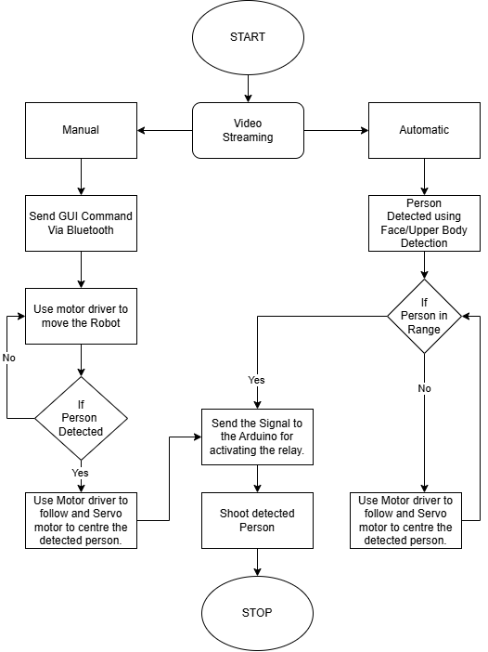
Methodology
Figure 1: Methodology Flowchart.

Slide 12
Work Done, Results, and Analysis
3D Frame Design: Completed 3D modeling and frame construction for the mobile turret.
Omnidirectional Mobility: Enabled autonomous omnidirectional movement.
Human Tracking: Achieved human tracking and following using Raspberry Pi 5.

Slide 13
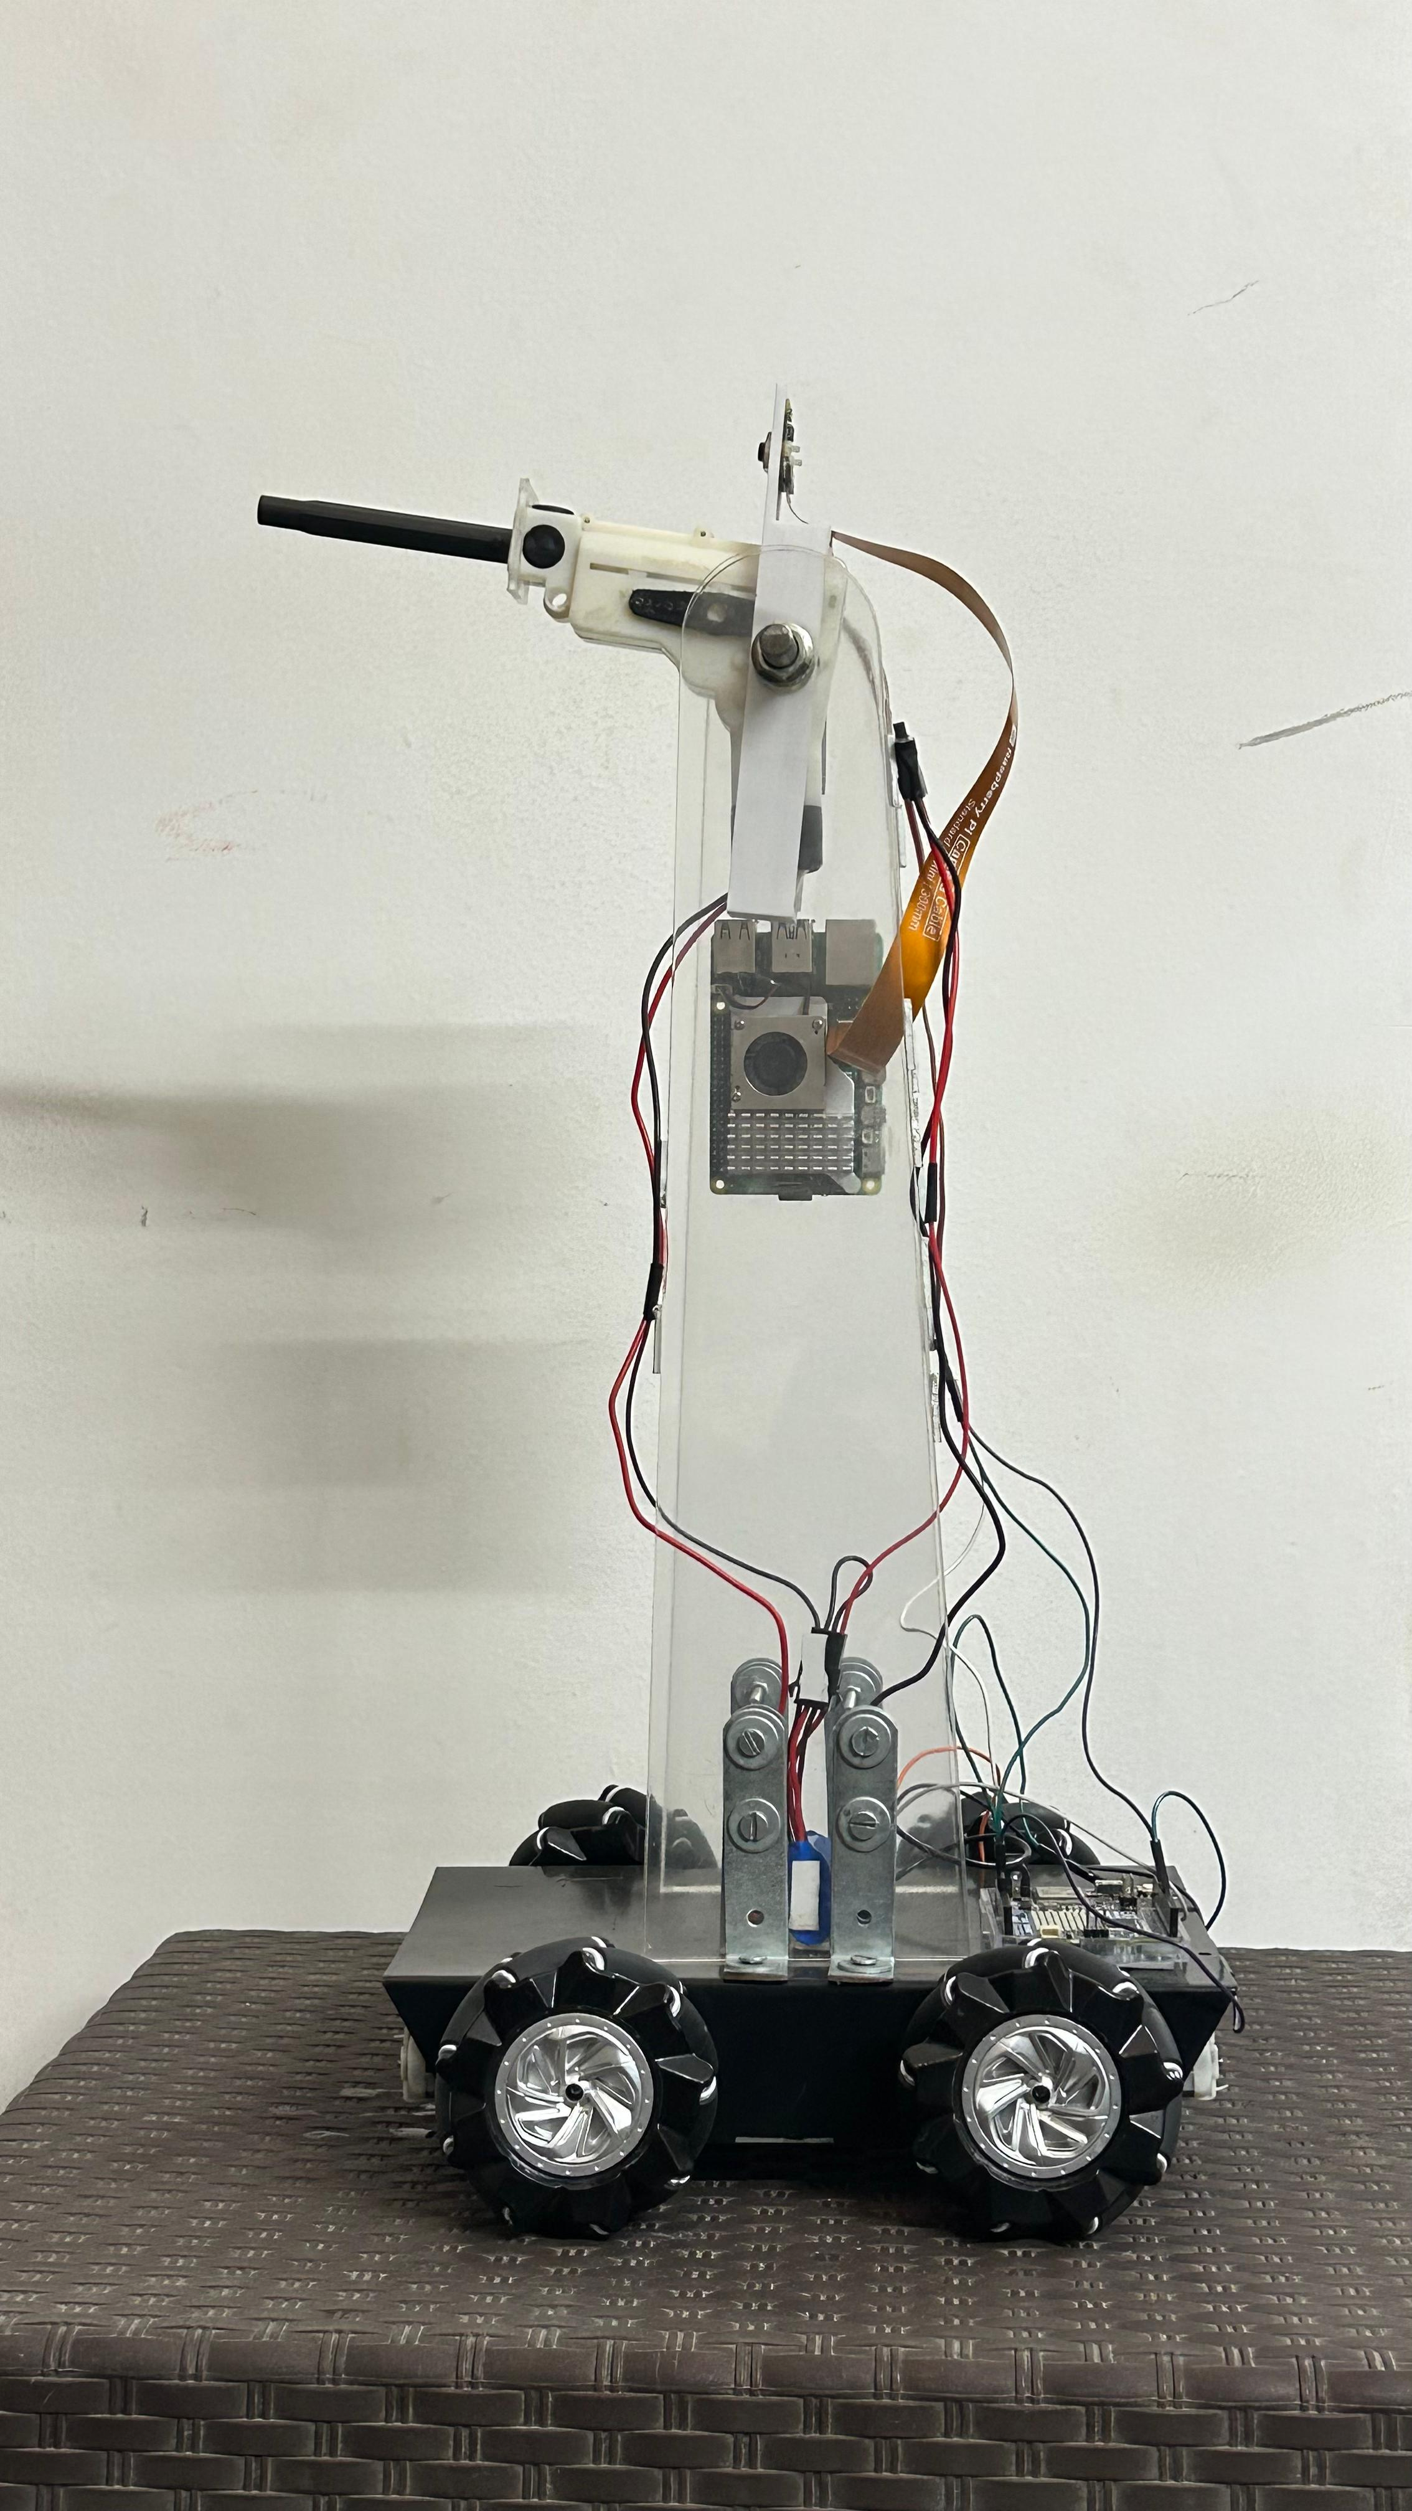
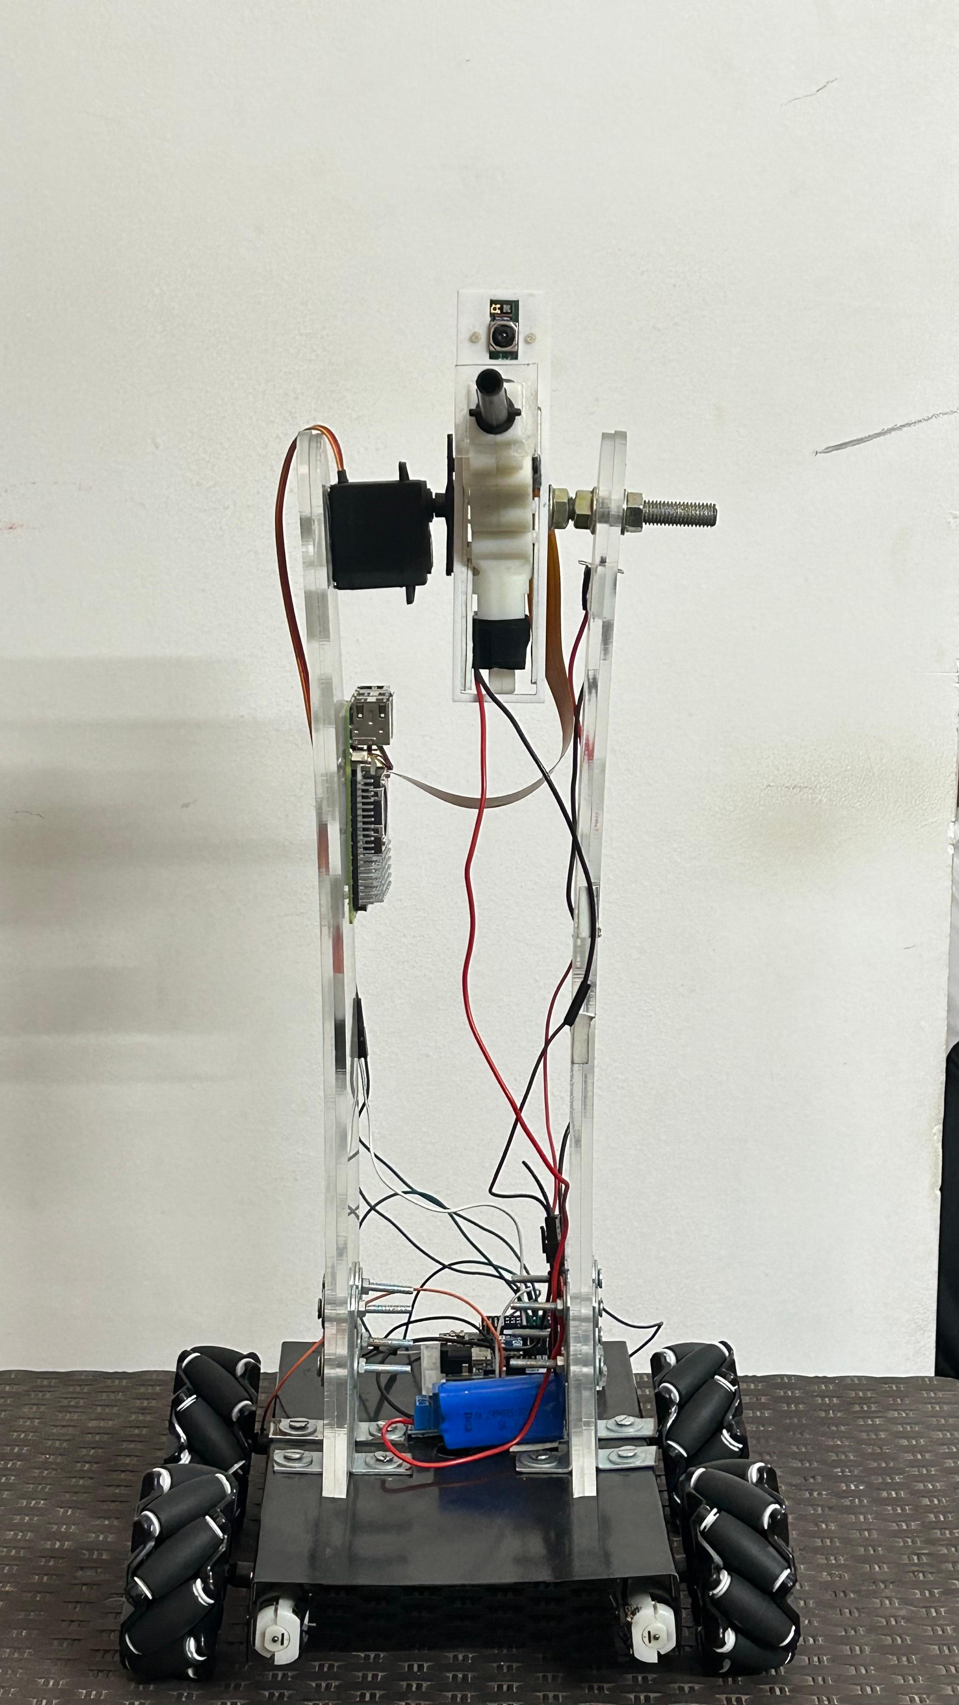
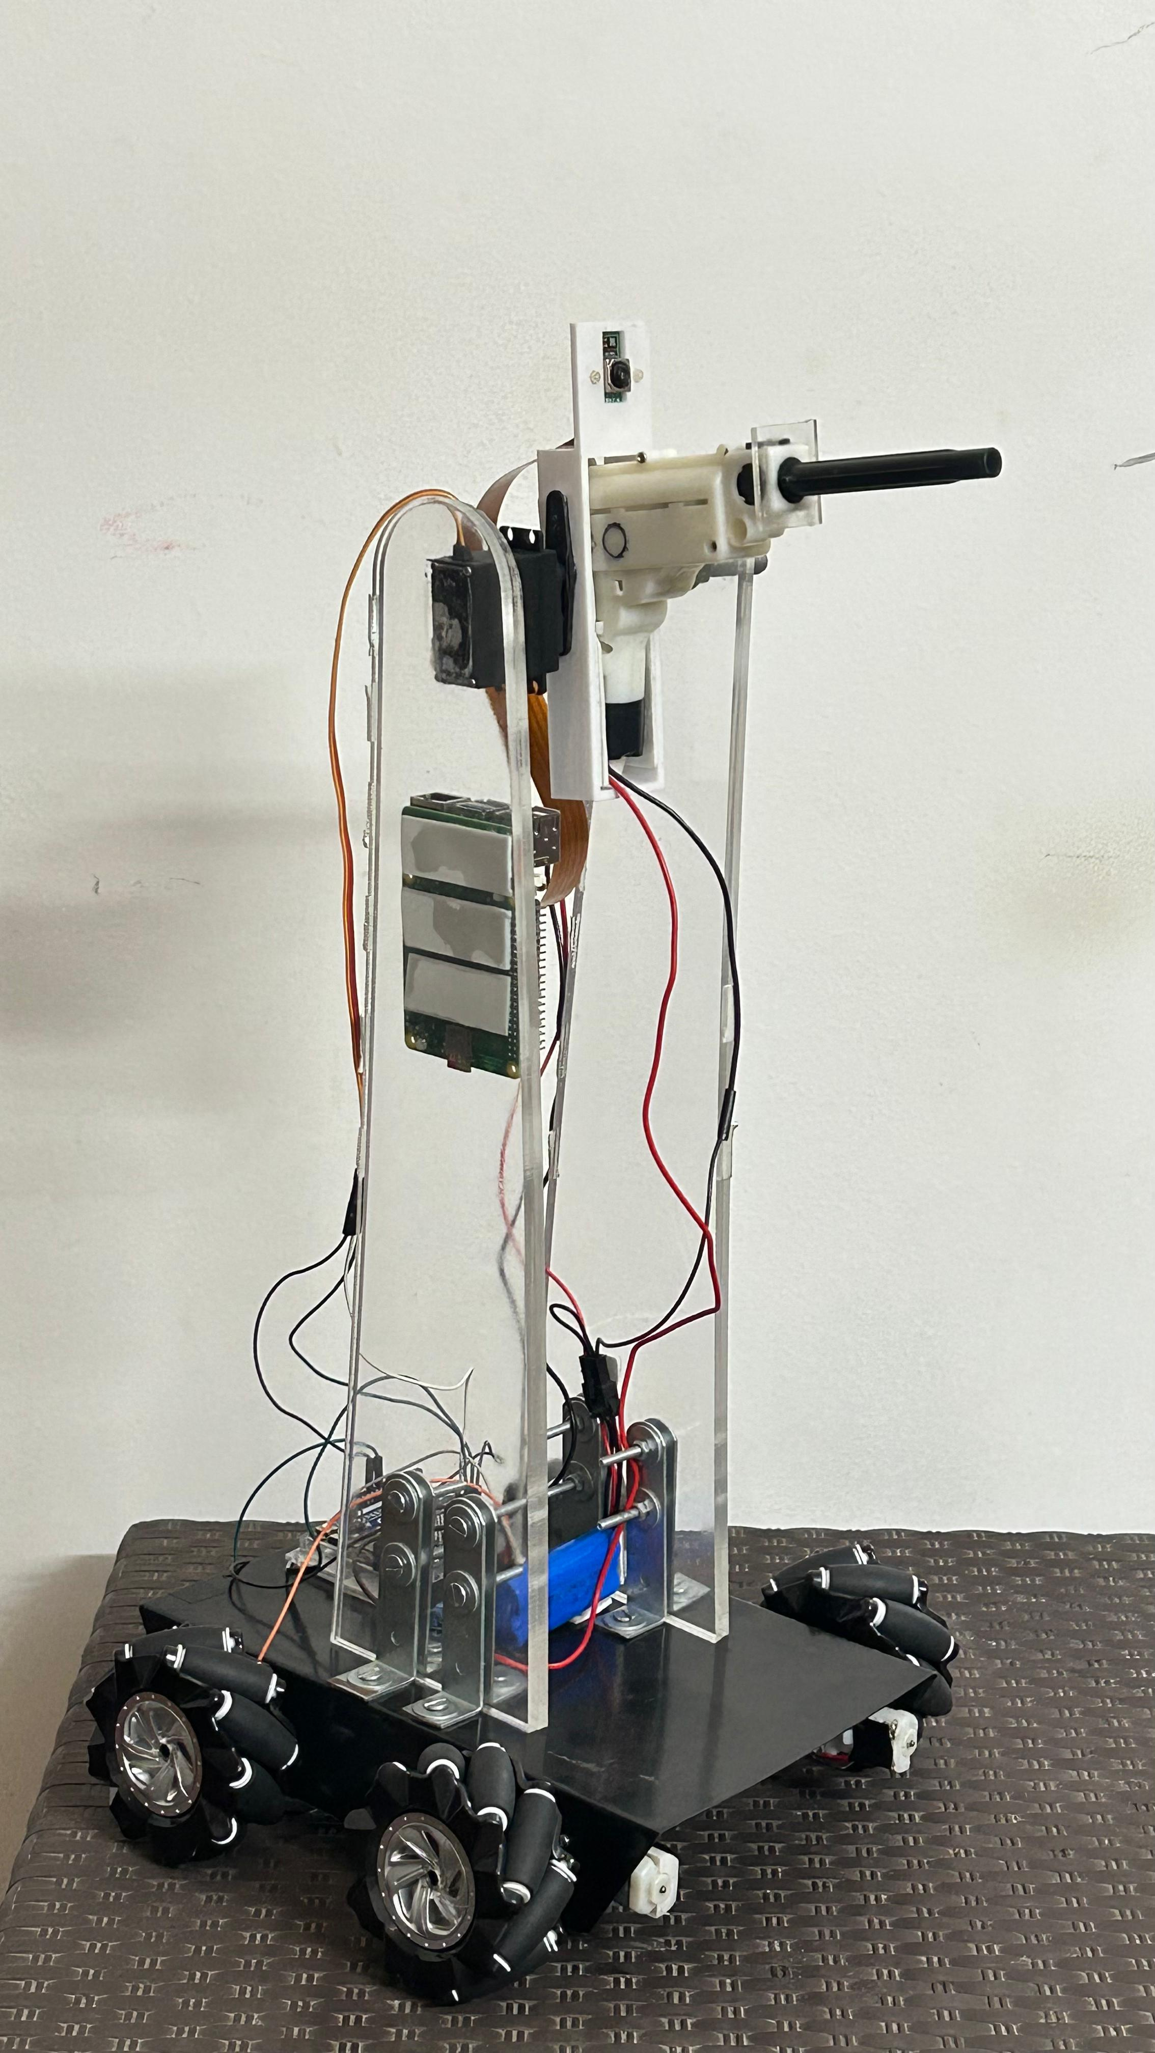
Work Done, Results, and Analysis
Figure 2a: Side view(Left) of the turret.
Figure 2b: Front view of the turret.
Figure 2c: Side view(Right) of the turret.

Slide 14
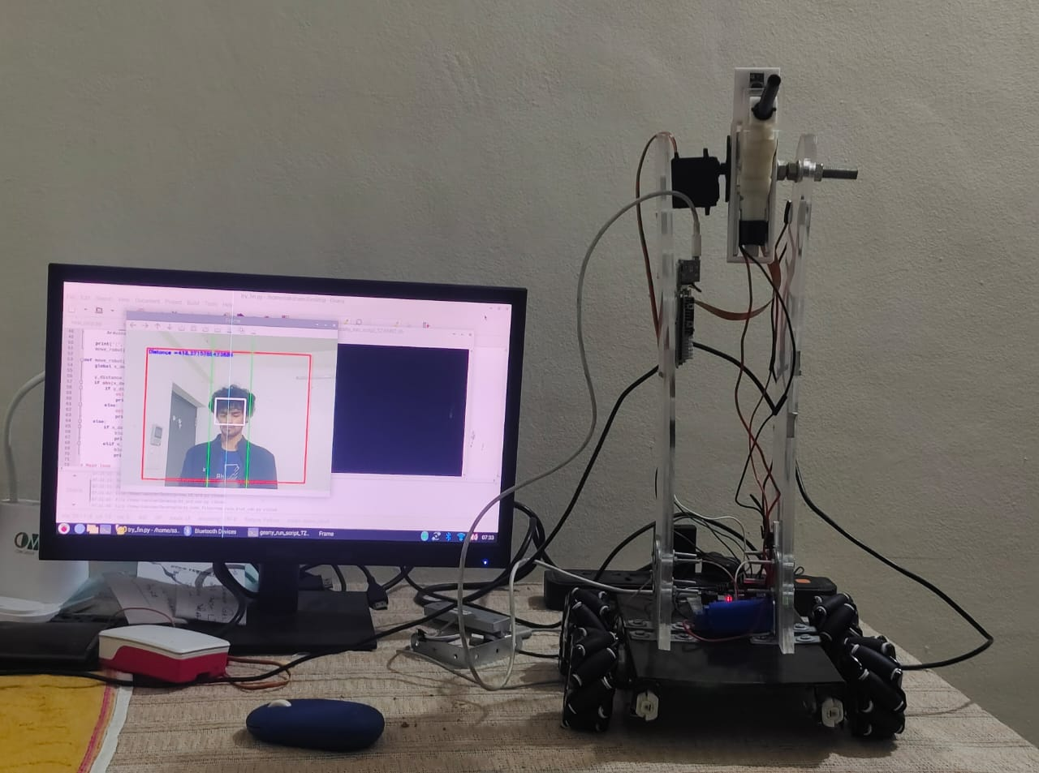
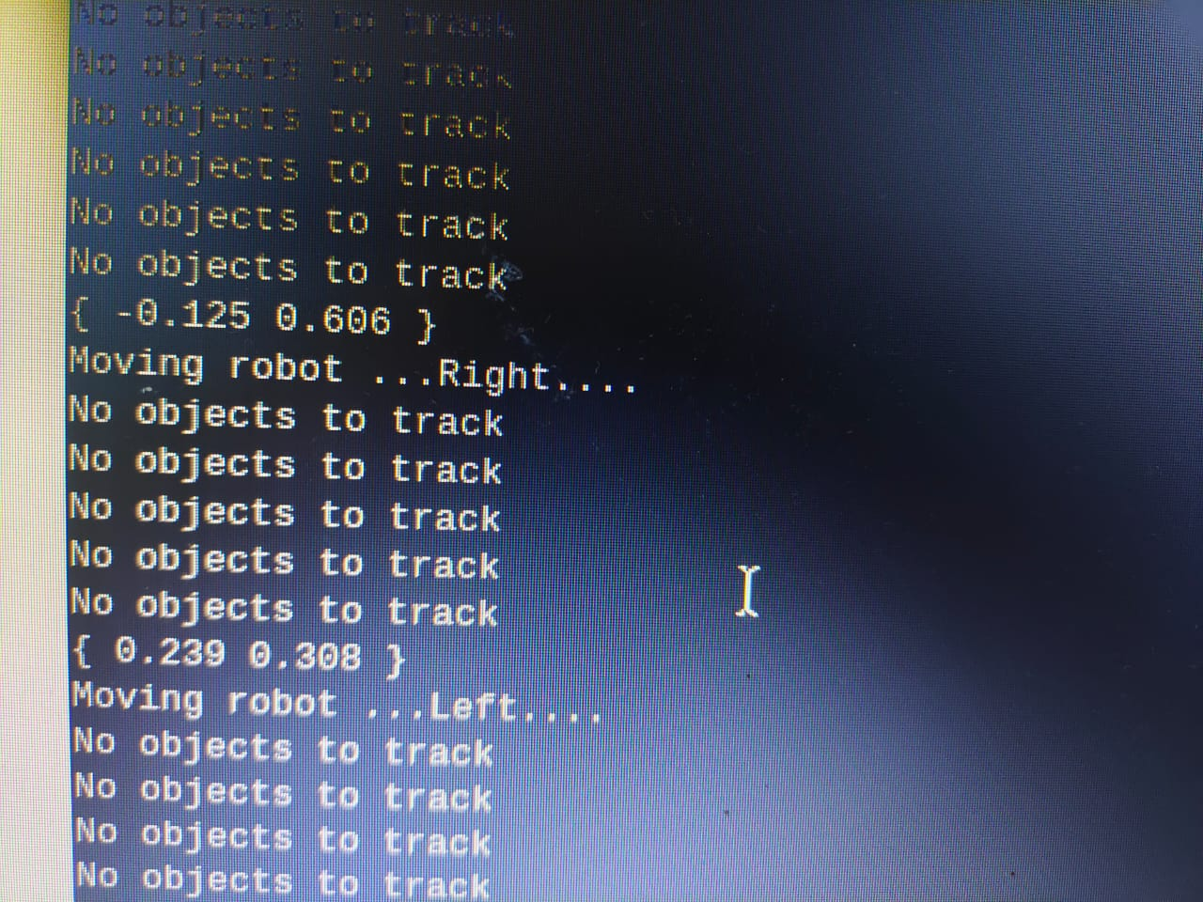
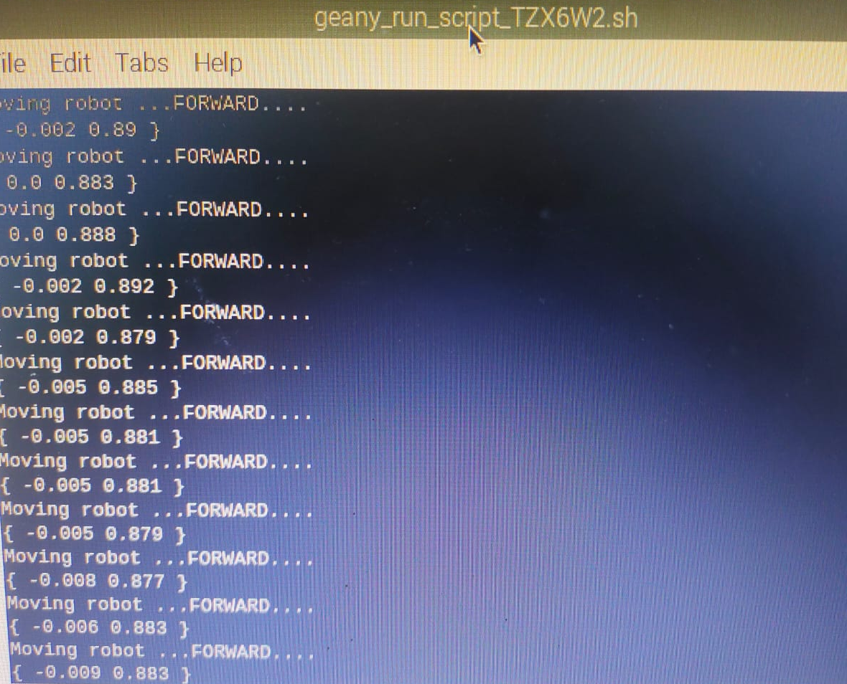
Work Done, Results, and Analysis
Figure 3b: Left/Right Commands sent for movement to Arduino
Figure 3c: Forward Command sent for movement to Arduino
Figure 3a: Upper body Detection and tracking

Slide 15
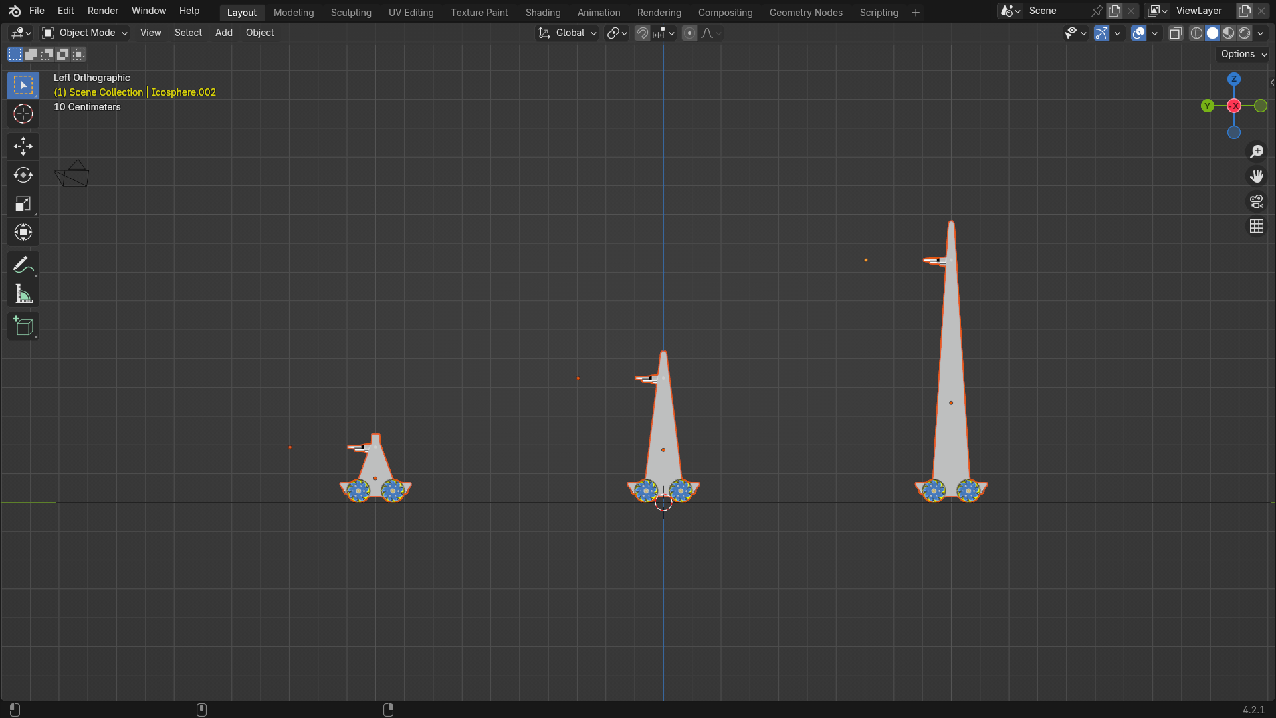
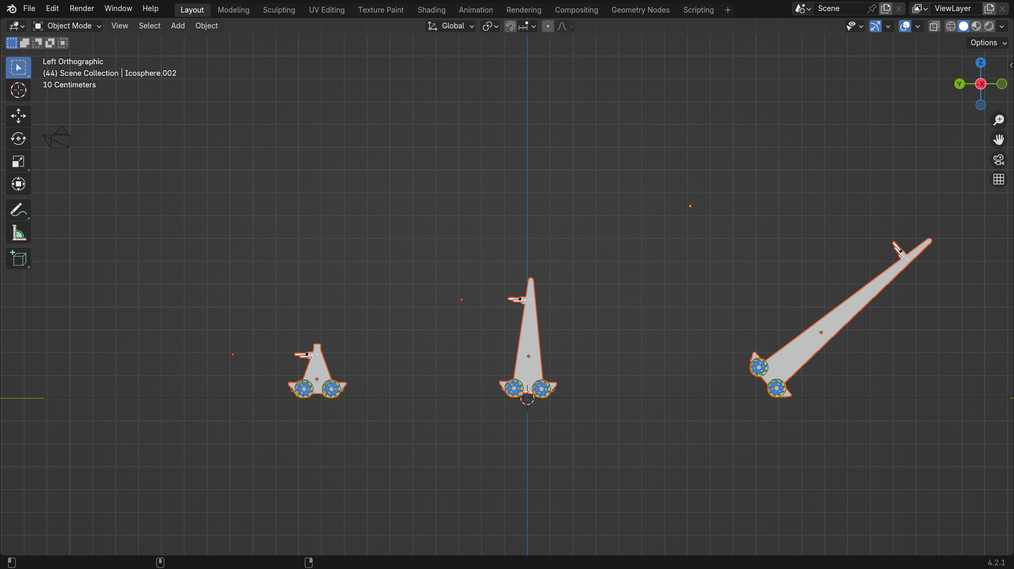
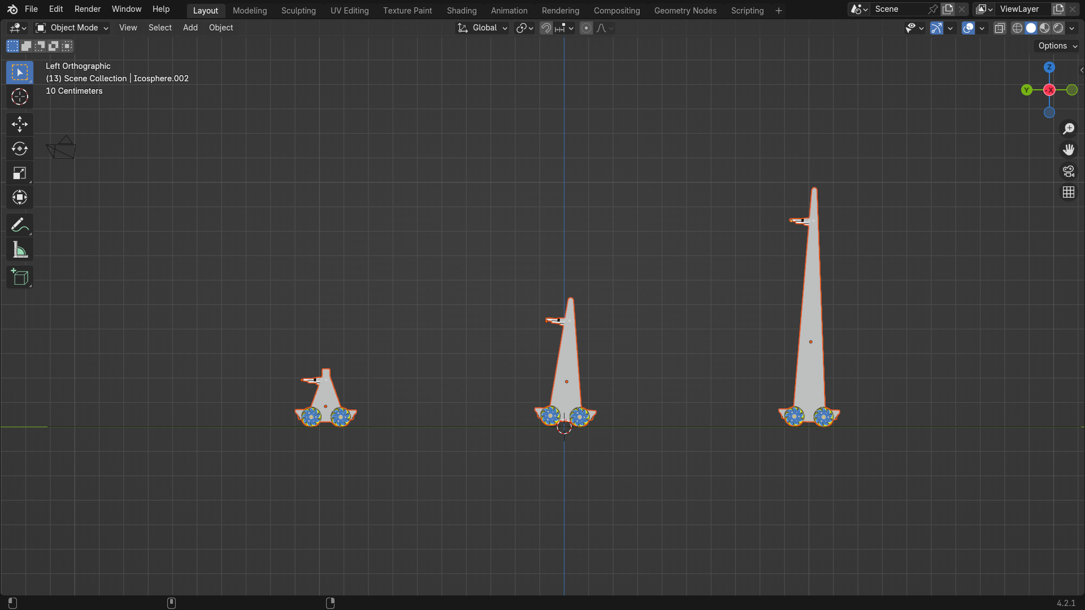
Work Done, Results, and Analysis
Figure 4c: Toppling of the 3.5 ft turret observed
Figure 4a: No Force applied at the top of the turret.
Figure 4b: Force applied at the top of the turret

Slide 16
Future Scope
Target Prioritization: Design an algorithm for efficient multi-target prioritization based on distance, speed, and threat level.
Mobile Power Solution: Integrate a portable, high-capacity battery for continuous Raspberry Pi 5 operation, ensuring continuous operation of the system while maintaining mobility and minimizing downtime.
SLAM & GPS: Add SLAM and GPS for autonomous navigation and precise real-time tracking.

Slide 17
Schedule of the Proposed Work
Sr. No. | Objective | Timeline of work
 |  | 29/7 – 2/8 | 5/8 – 9/8 | 12/8 – 16/8 | 19/8 – 23/8 | 26/8 – 30/8 | 2/9 – 6/9 | 9/9 – 19/9 | 16/9 – 20/9 | 23/9 – 27/9 | 30/9 – 4/10 | 7/10 – 11/10 | 14/10 – 18/10 | 21/10 – 25/10 | 28/10 – 31/10
1 | Turret Frame Model and Build
2 | Object Detection and Tracking
3 | Fabrication of Mobile Turret

Slide 18
Estimated expenditures
Sr. no. | Item | Quantity | Price (Rs.) | Amount (Rs.)
1. | Pimoroni Motor 2040 | 1 | 2050 | 2050
2. | JST SH wires | 3 | 310 | 930
3. | Raspberry Pi 5 | 1 | 8350 | 8350
4. | Encoder Motors | 4 | 500 | 2000
5. | MG996R positional servo | 1 | 250 | 250
6. | Bluetooth module HC-05 | 1 | 200 | 200
7. | Mecanum wheels (pack of 4) | 1 | 780 | 780
8. | Raspberry Pi camera module V3 | 1 | 2070 | 2070
9. | Raspberry Pi 5 camera FPC cable 300mm | 1 | 200 | 200
10. | Relay 5V | 1 | 80 | 80
11. | Battery 3.7V 2000mAh 3C Li-ion | 2 | 190 | 380
12. | Battery charger | 1 | 450 | 450
13. | Battery case | 1 | 30 | 30
14. | Power bank 10000mAh | 1 | 1000 | 1000
15. | Chassis | 1 | 330 | 330
Total: |  |  |  | 19100

Slide 19
References
Anna Annusewicz, The use of vision systems in the autonomous control of mobile robots equipped with a manipulator, Transportation Research Procedia, Volume 40, 2019, Pages 132-135, ISSN 2352-1465, https://doi.org/10.1016/j.trpro.2019.07.022.
Rahman, M.Z.U.; Raza, U.; Akbar, M.A.; Riaz, M.T.; Gumaei, A.H.; Ahmad, N. Radio-Controlled Intelligent UGV as a Spy Robot with Laser Targeting for Military Purposes. Axioms 2023, 12, 176. https://doi.org/10.3390/axioms12020176

Slide 20
References
Bermhed, C., & Holst, J. (2023). Design and Construction of an Autonomous Sentry Turret Utilizing Computer Vision. Bachelor's Programme in Mechatronics, Stockholm, Sweden.
Shahria MT, Sunny MSH, Zarif MII, Ghommam J, Ahamed SI, Rahman MH. A Comprehensive Review of Vision-Based Robotic Applications: Current State, Components, Approaches, Barriers, and Potential Solutions. Robotics.
2022; 11(6):139. https://doi.org/10.3390/robotics11060139

Slide 21
References
McMillen, John & Mitchell, Owen. (1985). An intelligent robot vision system for research applications.
40 - 45.10.1109/ROBOT.1985.1087366.
Medina-Santiago A, Morales-Rosales LA, Hernández-Gracidas CA, Algredo-Badillo I, Pano-Azucena AD, Orozco Torres JA. Reactive Obstacle–Avoidance Systems for Wheeled Mobile Robots Based on Artificial Intelligence. Applied Sciences. 2021; 11(14):6468. https://doi.org/10.3390/app11146468

